Slide 1
PEOPLE’S COMMITTEE OF BINH THANH DISTRICT DEPARTMENT OF EDUCATION AND TRAINING
GRADE 4

Slide 3
Unit 2
My weekend
Lesson 6: skills time!

Slide 5
These answers

Slide 6
Speaking skill

Slide 7
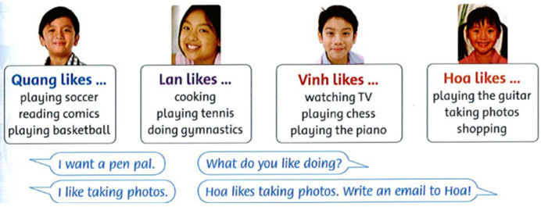
Ask and answer.

Slide 8
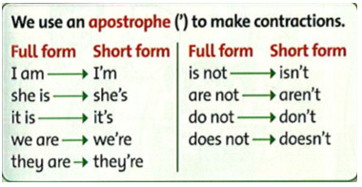
Guided Use apostrophe .

Slide 9
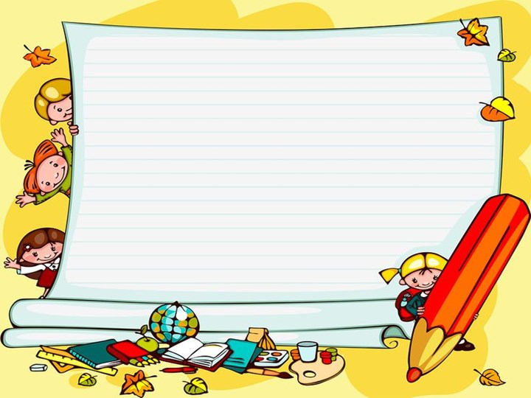
Use apostrophes write about your classmate.

Slide 10
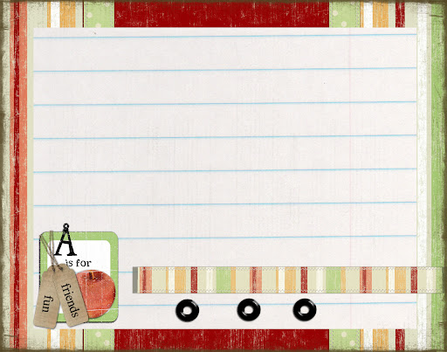
Examples:
He's eight.
She doesn't like ice cream.
1.
2.
3
4.

Slide 11
About my classmates
1. They’re students.
2.Hoang’s nine years old.
3.Nga and Hoang don’t like playing chess
4.Mai doesn’t like playing the guitar.

Slide 12
GAME TIME.
Yeah.

Slide 13
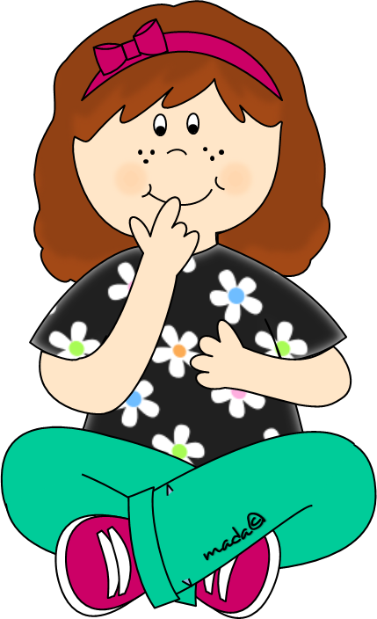
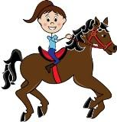
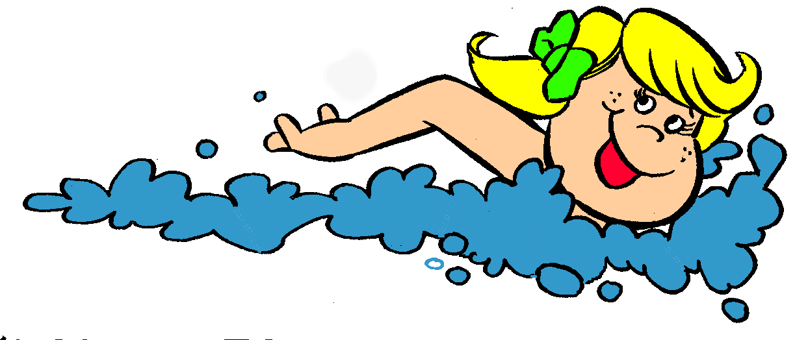
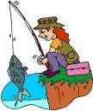
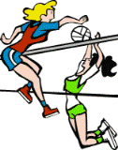

Slide 14
Amy likes fishing.
Amy likes playing volleyball.
Amy doesn’t like walking her dog.
Amy doesn’t like swimming.

Slide 15
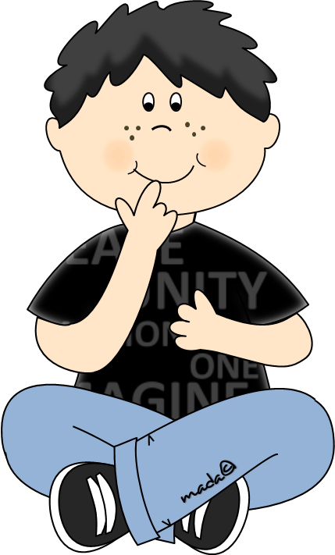
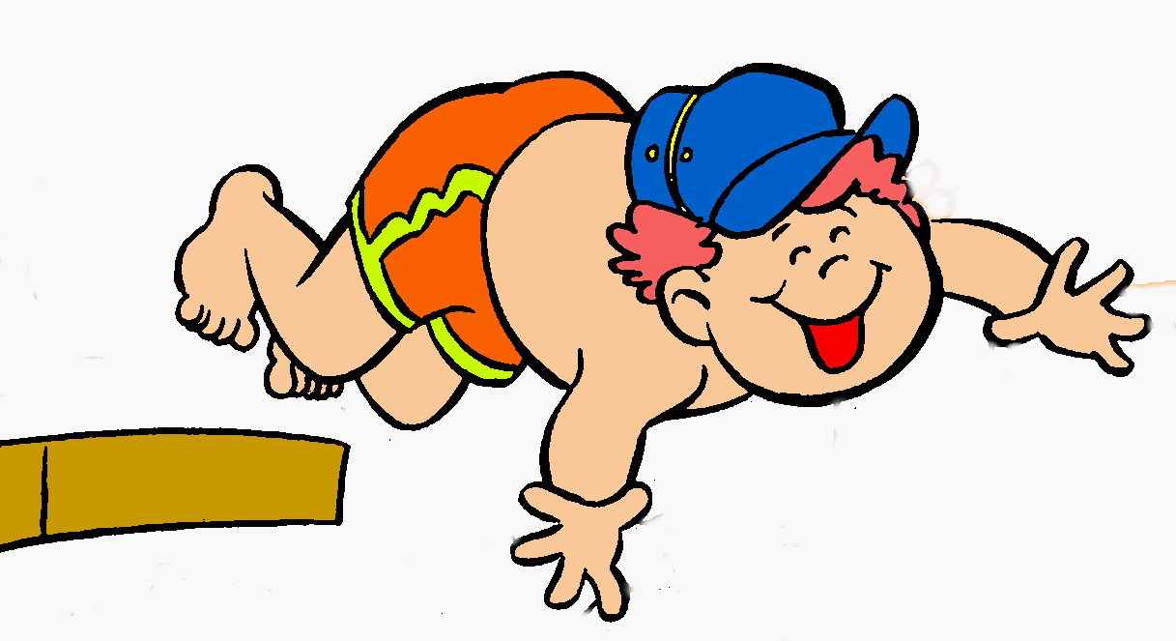
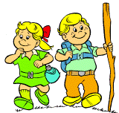
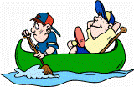
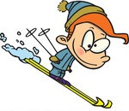
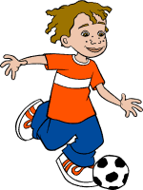

Slide 16
Tony likes flying his kite.
Tony doesn’t like playing football.
Tony likes taking photos.
Tony doesn’t like reading books.

Slide 17
Amy likes fishing.
Amy likes playing volleyball.
Amy doesn’t like walking her dog.
Amy doesn’t like swimming.

Slide 18
Tony likes flying his kite.
Tony doesn’t like playing football.
Tony likes taking photos.
Tony doesn’t like reading books.

